Slide 2
Continuous Variable
We use the mtcars dataset available in R
The data was extracted from the 1974 Motor Trend US magazine, and comprises fuel consumption and 10 aspects of automobile design and performance for 32 automobiles (1973–74 models).
A data frame with 32 observations on 11 (numeric) variables.
[, 1] mpg Miles/(US) gallon
[, 2] cyl Number of cylinders
[, 3] disp Displacement (cu.in.)
[, 4] hp Gross horsepower
[, 5] drat Rear axle ratio
[, 6] wt Weight (1000 lbs)
[, 7] qsec 1/4 mile time
[, 8] vs Engine (0 = V-shaped, 1 = straight)
[, 9] am Transmission (0 = automatic, 1 = manual)
[,10] gear Number of forward gears
[,11] carb Number of carburetors

Slide 3
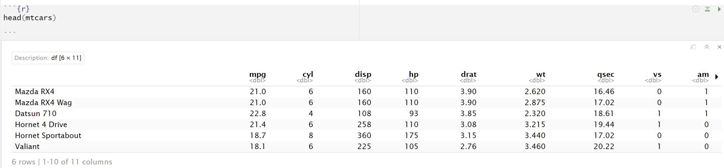
Continuous Variable
A quantitative variable is a numerical variable (a number) that can take a large number values. For example: age, avg_glucose_level, bmi
Displaying the data, we use the head() function. For more information about the head() function, type ?head in the Rstudio console

Slide 4
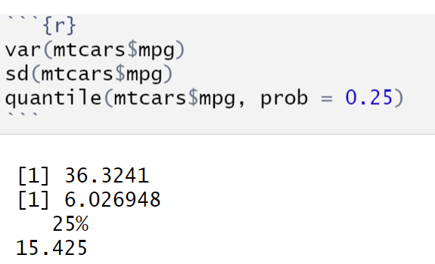
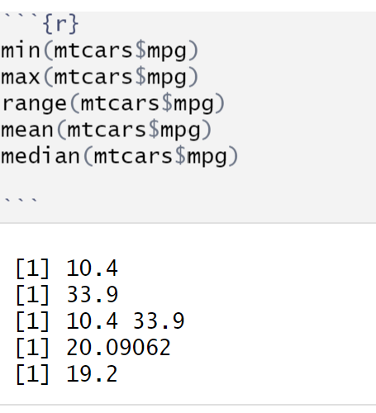
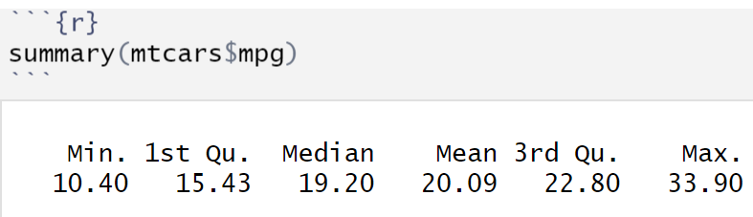
Continuous Variable
Centrality indicators, use the functions min() (minimum), max() (maximum), range() (min max), mean() (Average) median() (median)
Dispersion indicators, use the functions var() (vaiance), sd() (standard deviation), quantile() (quantile)
We can also use the summary() function, to calculate all these indicators for all variables

Slide 5
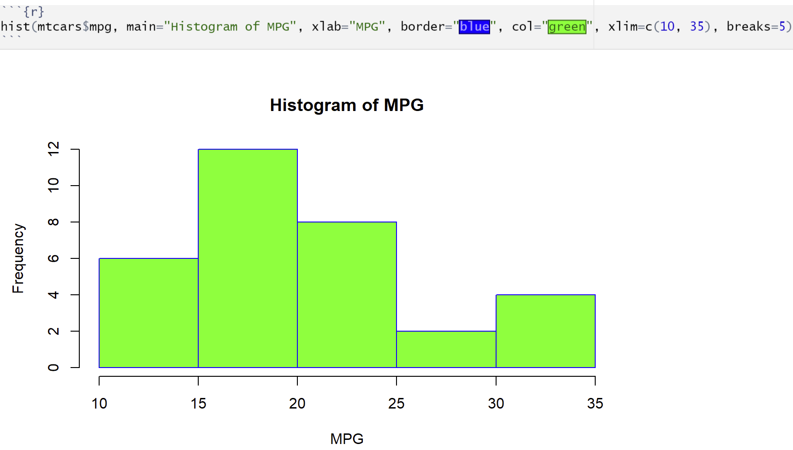
Histogram
Histogram, Using the hist() function, To understand all the arguments of the function, ?hist()
main, xlab, ylab: main title and axis labels
border: the color of the border around the bars.
col: a colour to be used to fill the bars.
xlim, ylim: the range of x and y values with sensible defaults
breaks: controls the number of bars, cells or bins of the histogram
Border: an optional vector of colors for the outlines of the boxplots.

Slide 6
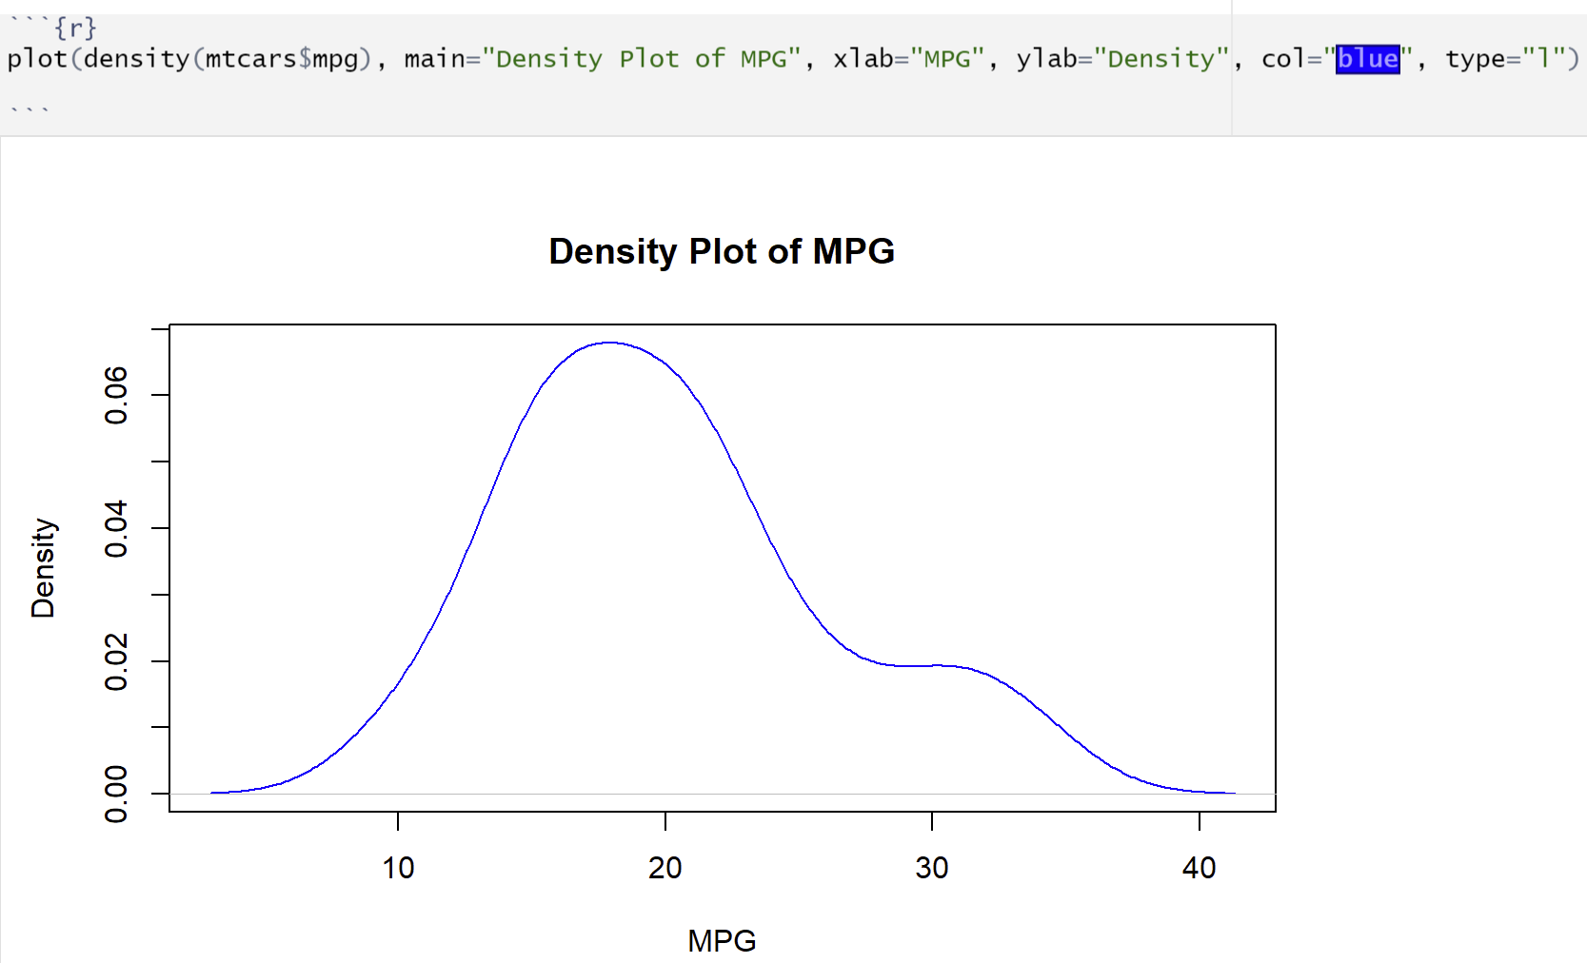
Density Plot
Histogram, Using the plot() function, To understand all the arguments of the function, ?plot()
main, xlab, ylab: main title and axis labels
col: a colour of line.
type: what type of plot should be drawn. Possible types are
"p" for points,
"l" for lines,
"b" for both,
"c" for the lines part alone of "b",
"o" for both ‘overplotted’,
"h" for ‘histogram’ like (or ‘high-density’) vertical lines,
"s" for stair steps,
"S" for other steps
"n" for no plotting.

Slide 7
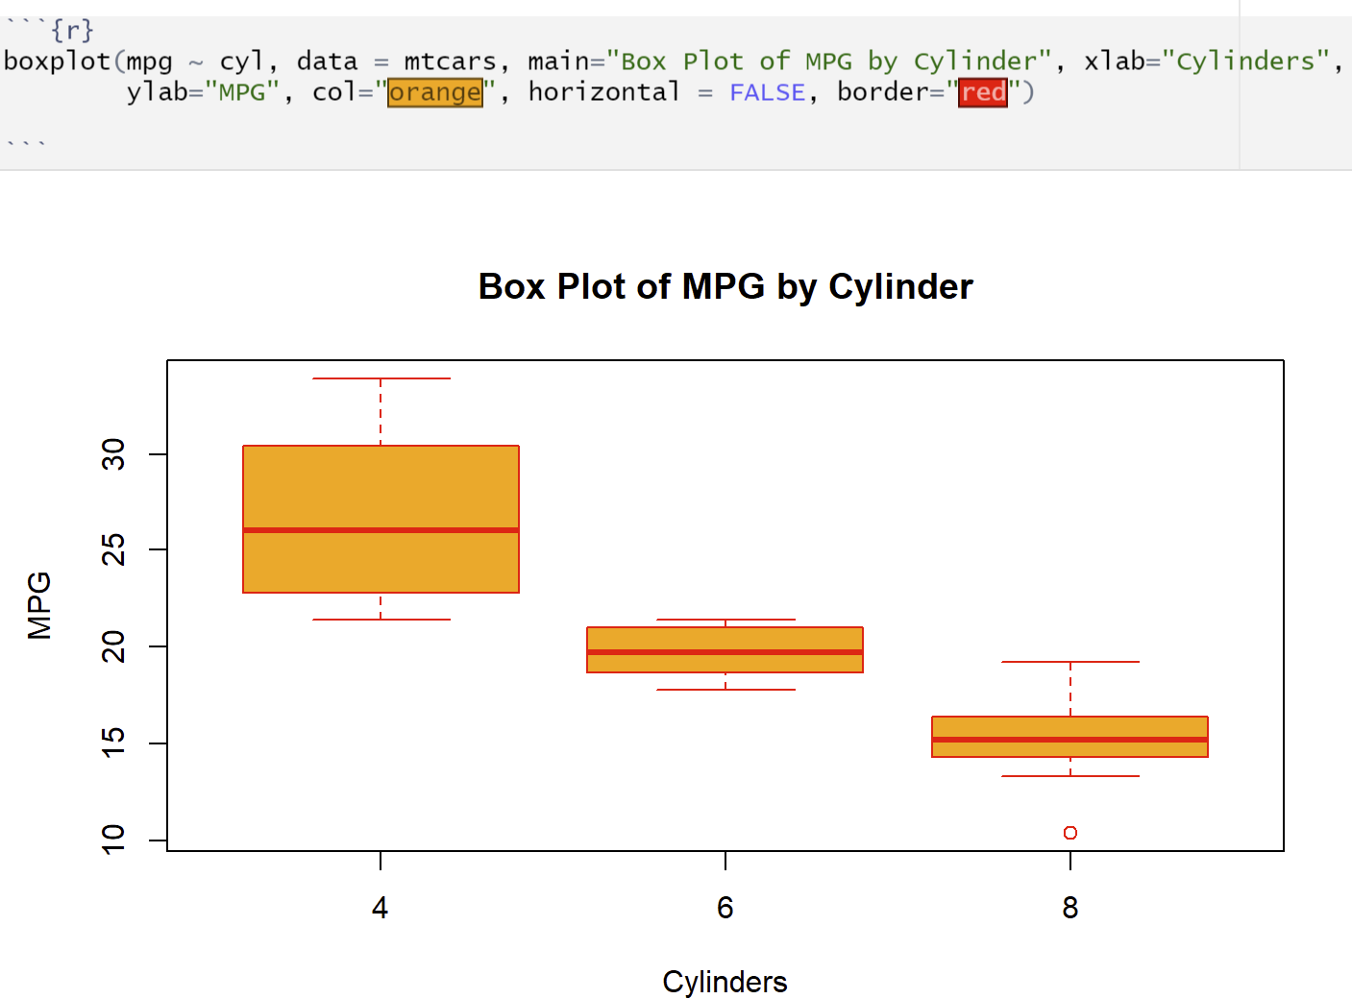
Box plot
Boxplot, Using the boxplot() function, To understand all the arguments of the function, ?boxplot()
main, xlab, ylab: main title and axis labels
col: a colour of boxplot.
Horizontal: logical indicating if the boxplots should be horizontal; default FALSE means vertical boxes.
Border: an optional vector of colors for the outlines of the boxplots.

Slide 8
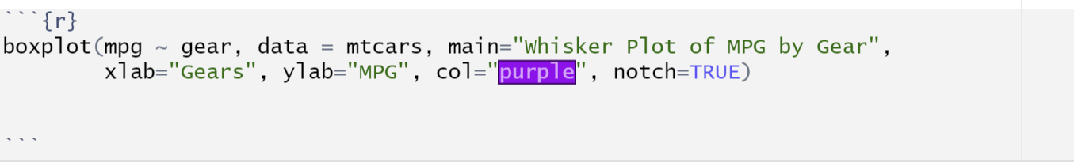
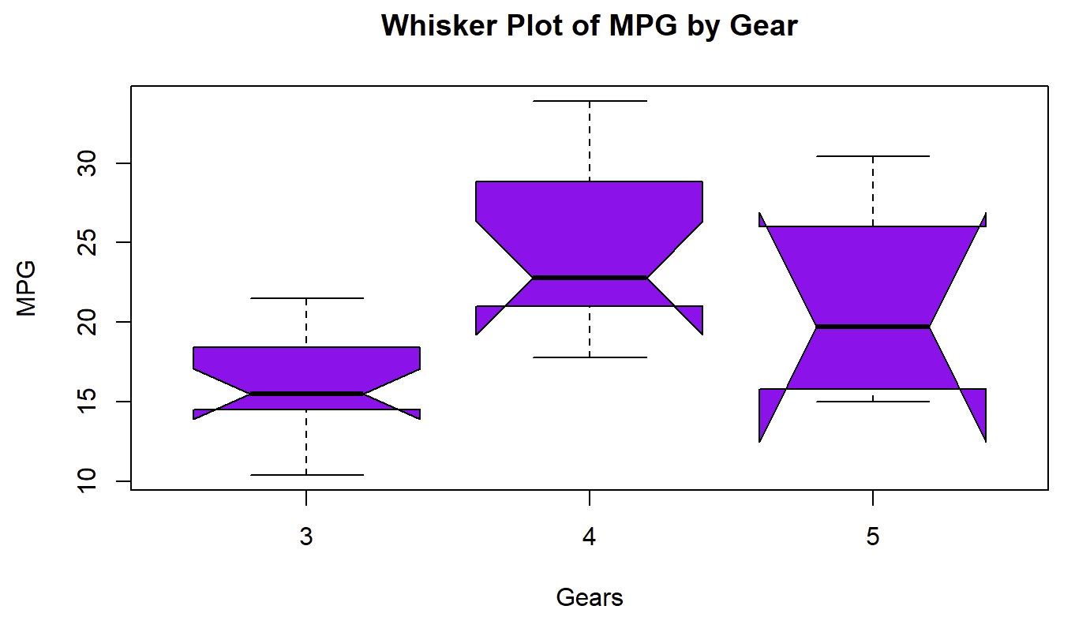
Whisker Plot
Whisker Plot, Using the boxplot() function, To understand all the arguments of the function, ?boxplot()
main, xlab, ylab: main title and axis labels
col: a colour of boxplot.
Horizontal: logical indicating if the boxplots should be horizontal; default FALSE means vertical boxes.
Border: an optional vector of colors for the outlines of the boxplots.
Notch: if notch is TRUE, a notch is drawn in each side of the boxes.

Slide 9
Venn Diagram
Venn diagram is the graphical representation of sets used for showing the relationship between them.
Syntax
install.packages(“VennDiagram”)
library(“VennDiagram”)
Parameters:
area1: The size of first set
area2: The size of second set
area3: The size of third set
cross.area: The size of the intersection between the sets
n12: The size of intersection between the first and second set
n23: The size of intersection between the third and second set
n13: The size of intersection between the first and third set
n123: The size of intersection between all the three sets
col: A vector giving the colours of the circle’s circumference
fill: A vector giving the colours to circle’s area
category: A vector of strings giving the category names of the sets
For two sets:
Syntax:
grid.newpage()
draw.pairwise.venn(area1,area2,cross.area,col,fill)
For three sets:
Syntax:
grid.newpage()
draw.triple.venn(area1,area2, area3,n12,n23,n13, n123,category)

Slide 10
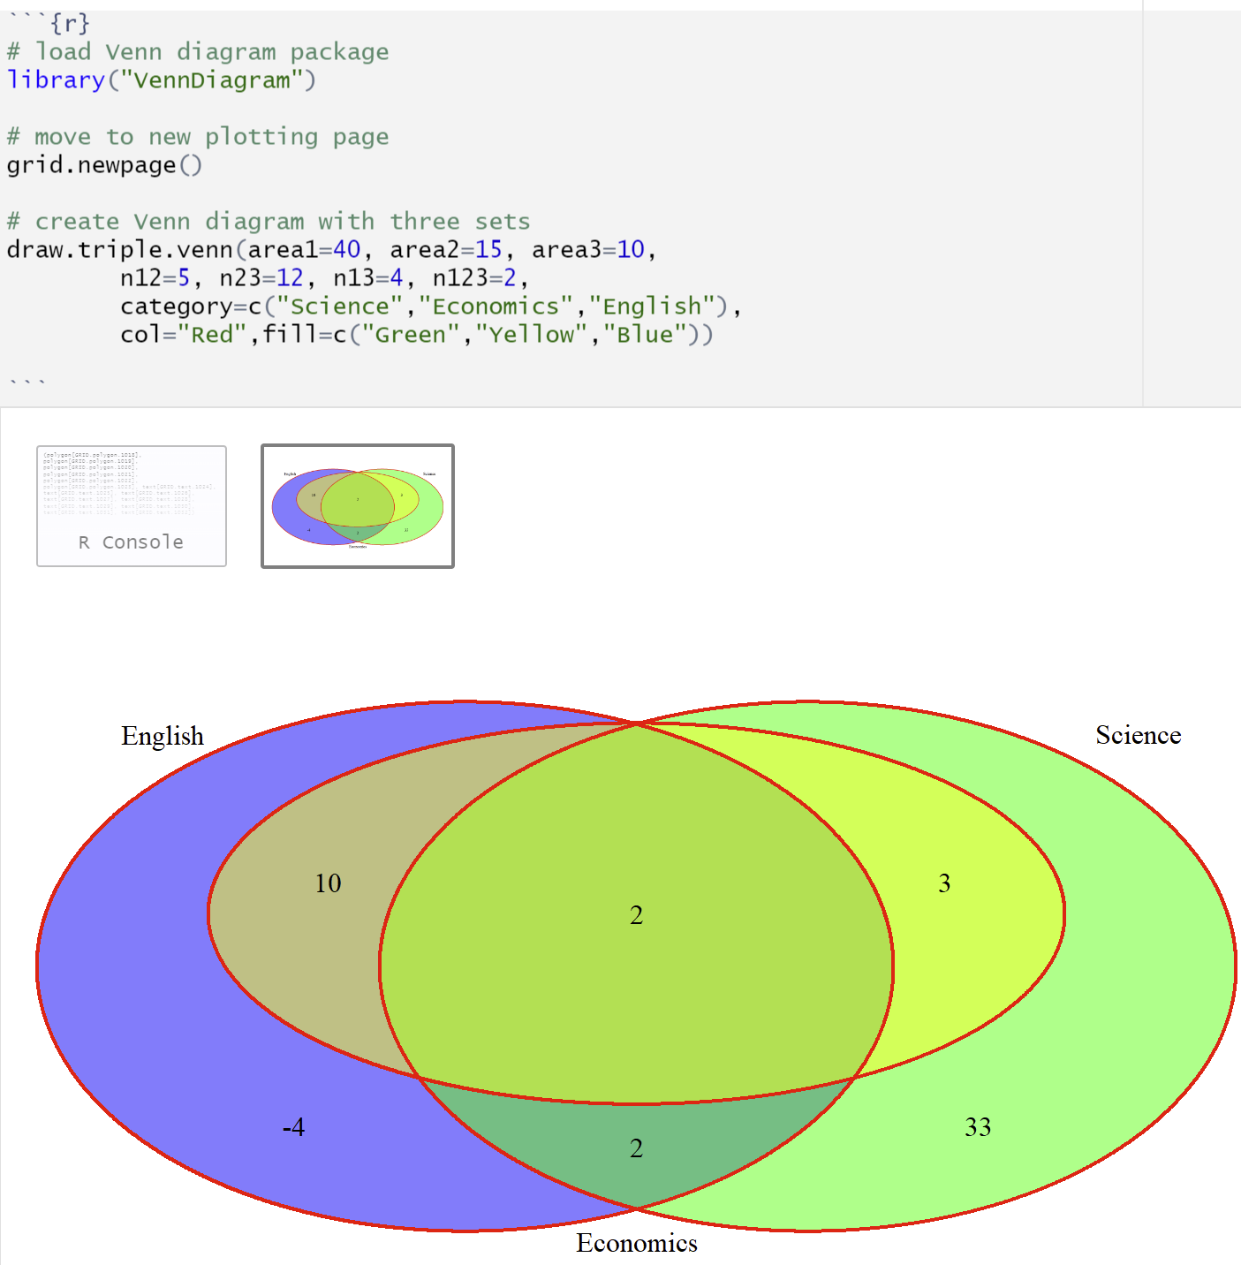
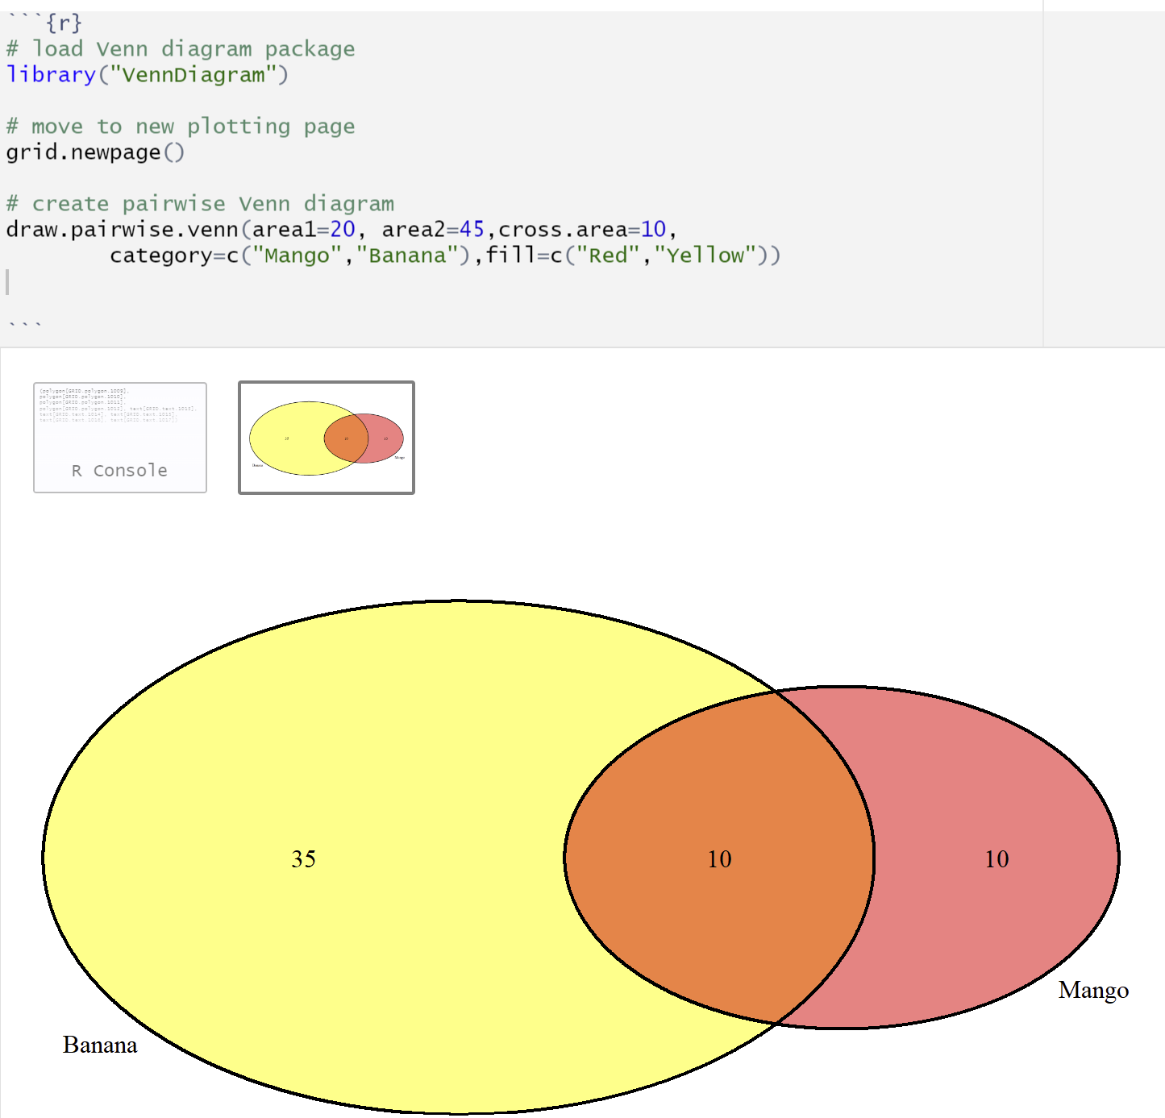
Venn Diagram

Slide 11
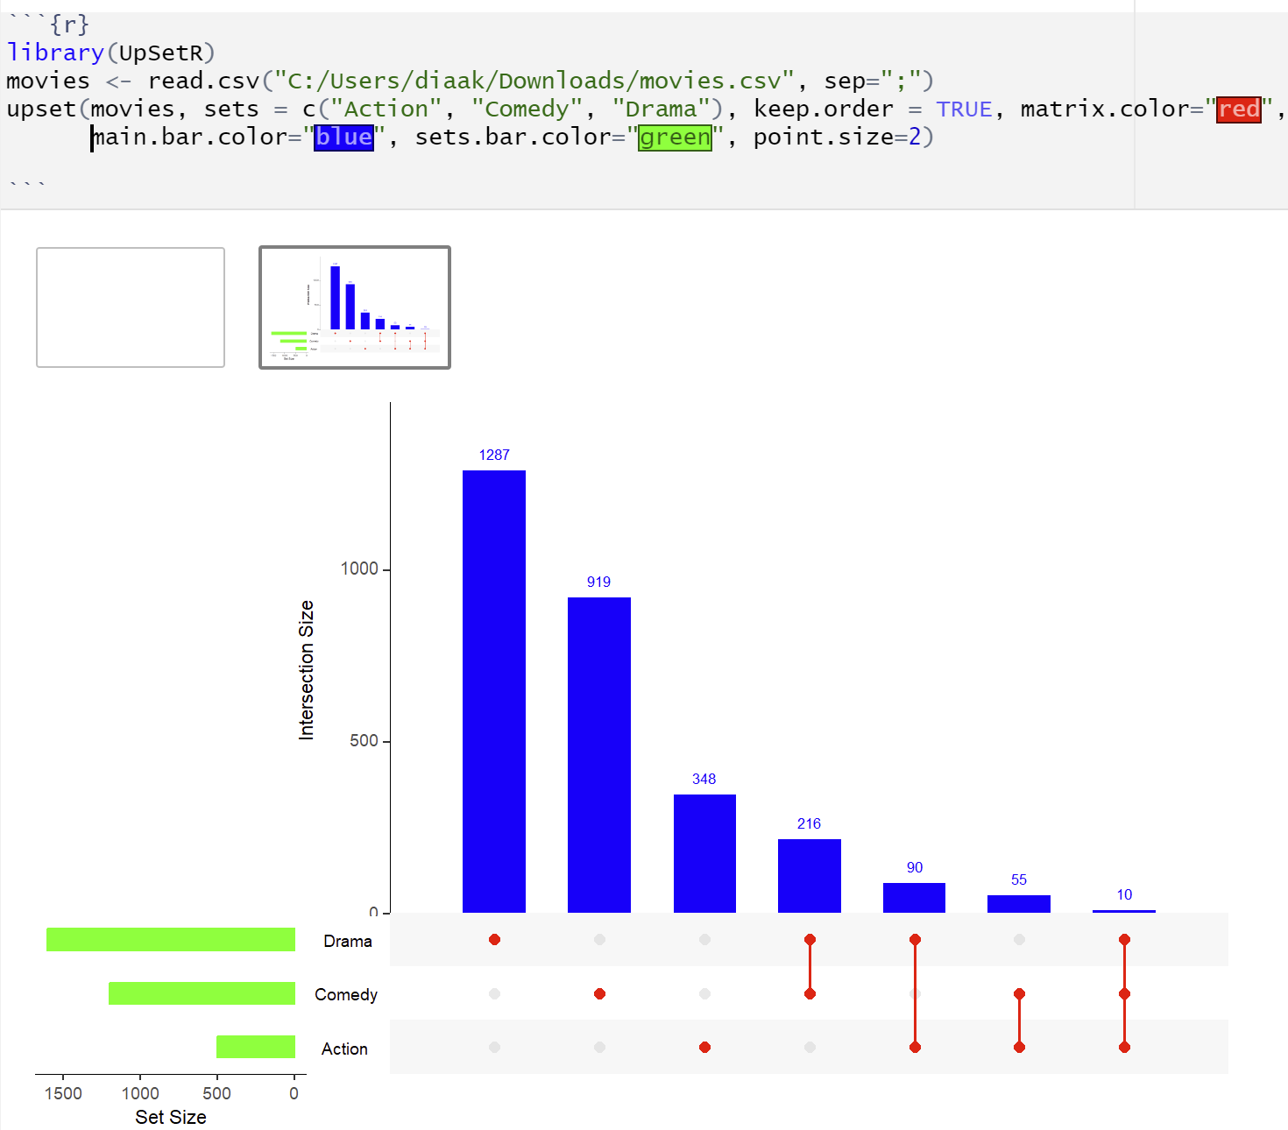
Upset Plot
To visualize the intersection between more than 3 sets, the best option is to use an UpSet plot.
The total size of each set is represented on the left barplot. Every possible intersection is represented by the bottom plot, and their occurence is shown on the top barplot. Use the UpSetR package and upset() function
sets: specific sets to look at (include as combinations. ex: c("name1", "name2"))
keep.order: keep sets in the order entered using the sets parameter.
matrix.color: color of the intersection points
main.bar.color: color of the main bar plot
sets.bar.color: color of set size bar plot
point.size: size of points in matrix plot

Slide 12
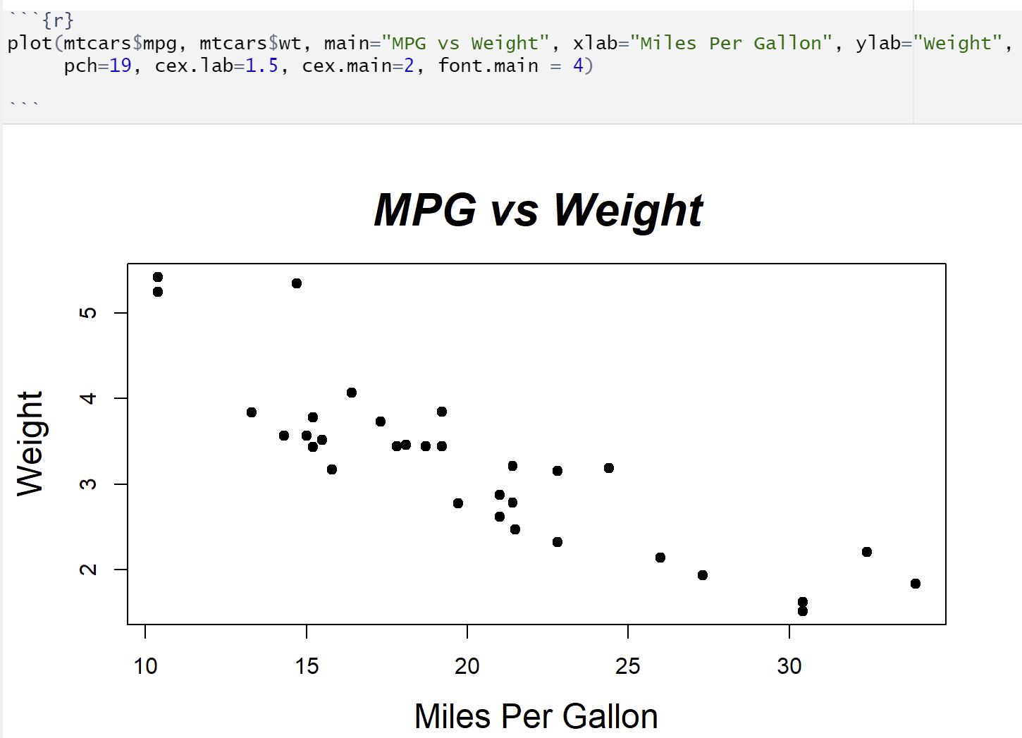
Point Cloud
main: a main title for the plot
xlab: a label for the x axis, defaults to a description of x.
ylab: a label for the y axis, defaults to a description of y.
pch: a vector of plotting characters or symbols: see points.
cex: a numerical vector giving the amount by which plotting characters and symbols should be scaled relative to the default.
font.main: main font

Slide 13
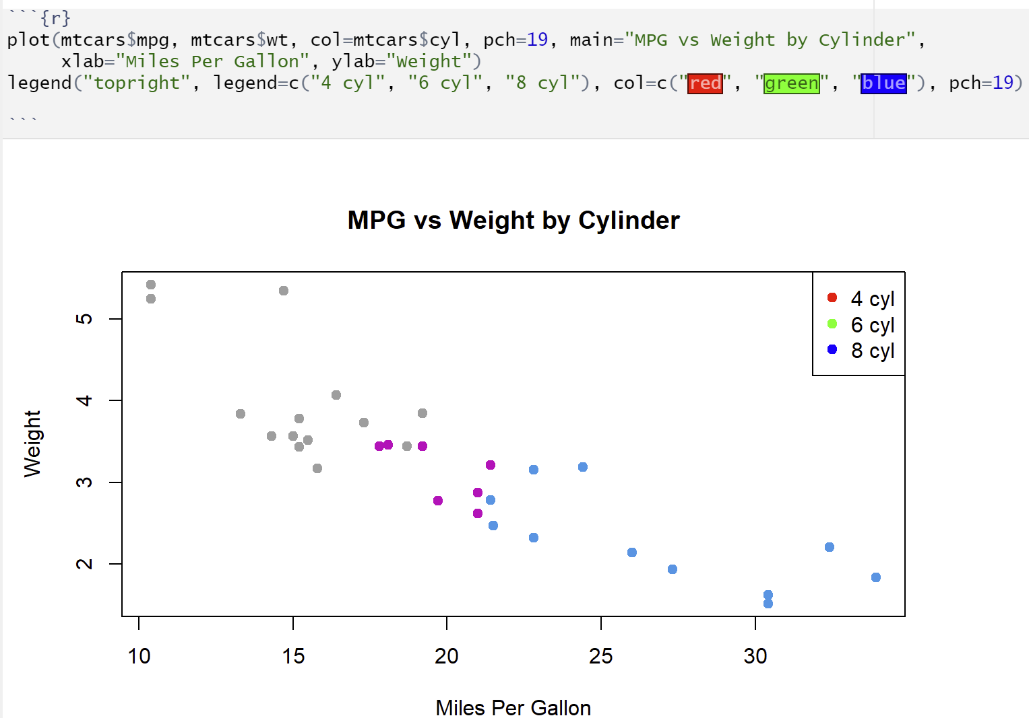
Point Cloud – Adding legend
To add legend, we use legend() function

Slide 14
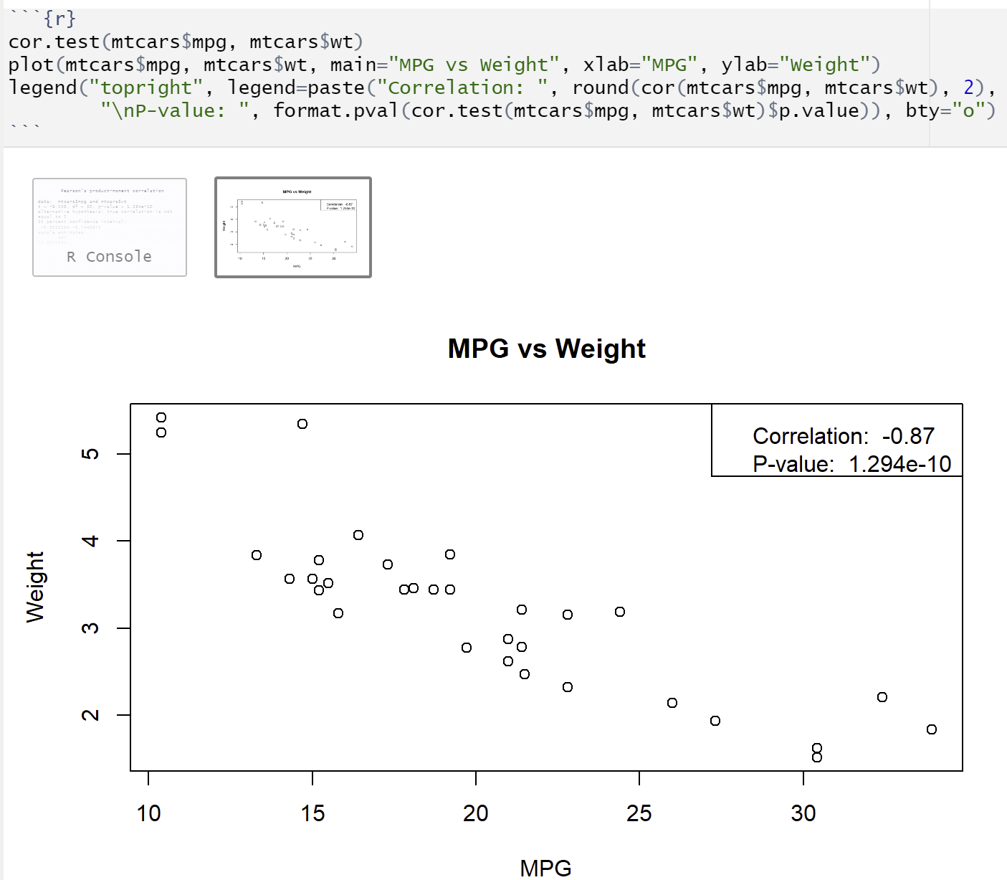
Point Cloud – Adding Correlation and P-value
round(cor(mtcars$mpg, mtcars$wt), 2): calculates correlation to two decimal places
format.pval(cor.test(mtcars$mpg, mtcars$wt)$p.value)): calculates p-value
bty: the type of box to be drawn around the legend. the allowed values are "o" (the default) and "n"
Linear correlation (Pearson) Correlation is a measure of the linear association between two quantitative variables. We use the cor() function.
For Spearman correlation, we always use the function cor() with the argument method = "spearman"

Slide 15
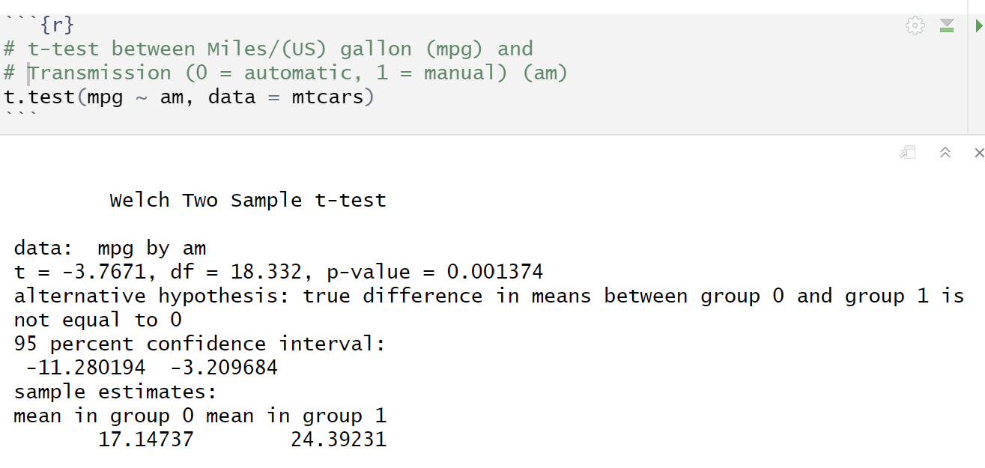
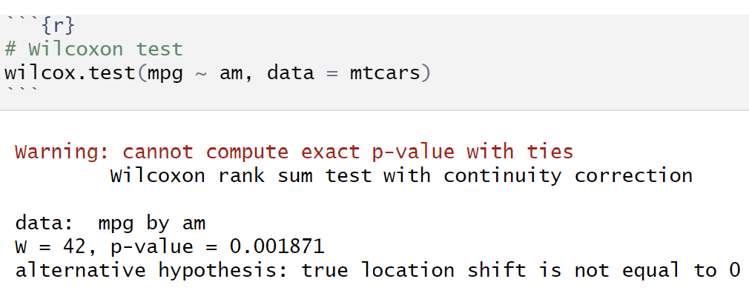
Statistical tests
Student's t-Test:
t.test() Performs one and two sample t-tests on vectors of data.
Wilcoxon Rank Sum and Signed Rank Tests
Wilcox.test() Performs one- and two-sample Wilcoxon tests on vectors of data; the latter is also known as ‘Mann-Whitney’ test.
Others arguments
alternative: a character string specifying the alternative hypothesis, must be one of "two.sided" (default), "greater" or "less". you can specify just the initial letter.
mu:a number specifying an optional parameter used to form the null hypothesis
paired: a logical indicating whether you want a paired test.
exact: a logical indicating whether an exact p-value should be computed.
correct: a logical indicating whether to apply continuity correction in the normal approximation for the p-value.
conf.int: a logical indicating whether a confidence interval should be computed.
conf.level: confidence level of the interval.

Slide 16
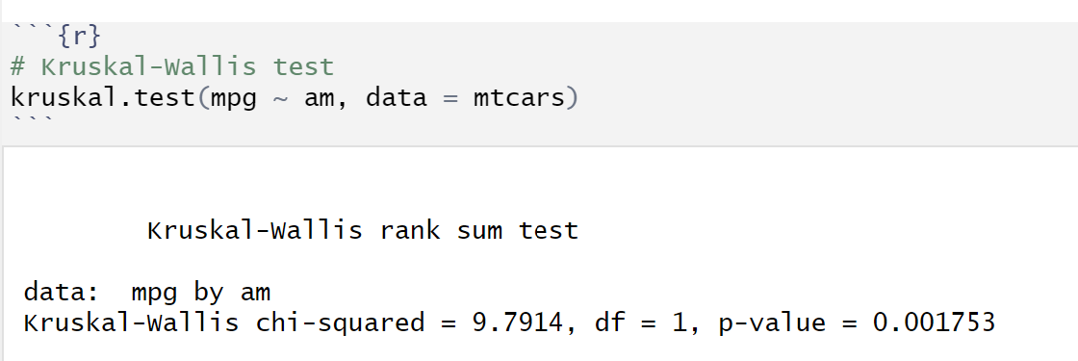
Statistical tests
Kruskal-Wallis Rank Sum Test
kruskal.test() performs a Kruskal-Wallis rank sum test of the null that the location parameters of the distribution of x are the same in each group (sample). The alternative is that they differ in at least one.

Slide 17
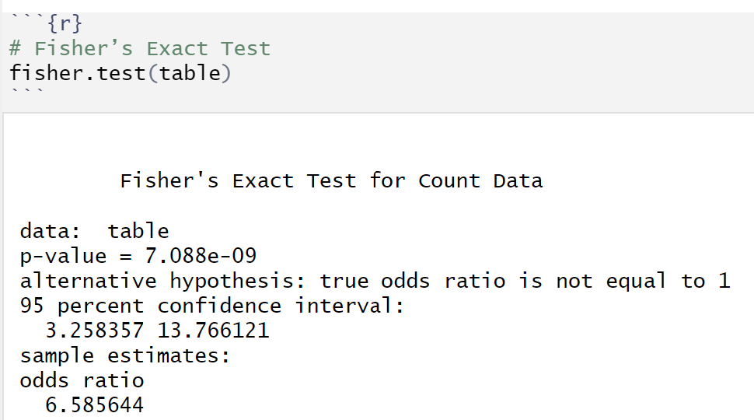
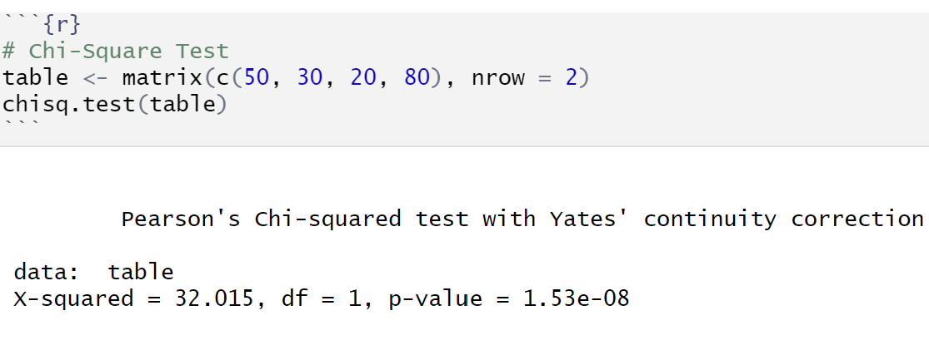
Statistical tests – binary variable
Binary Variables: Variables with two categories (e.g., yes/no, male/female)
Fisher's Exact Test for Count Data
fisher.test() Performs Fisher's exact test for testing the null of independence of rows and columns in a contingency table with fixed marginals.
Pearson's Chi-squared Test for Count Data
chisq.test() performs chi-squared contingency table tests and goodness-of-fit tests.
Arguments:
alternative: indicates the alternative hypothesis and must be one of "two.sided", "greater" or "less". you can specify just the initial letter.
conf.int: logical indicating if a confidence interval for the odds ratio in a 2×2 table should be computed (and returned).
conf.level: confidence level for the returned confidence interval. only used in the 2×2 case and if conf.int = true.
simulate.p.value: a logical indicating whether to compute p-values by monte carlo simulation, in larger than 2×2 tables.

Slide 18
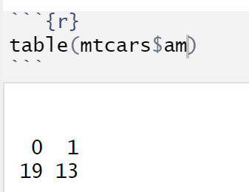
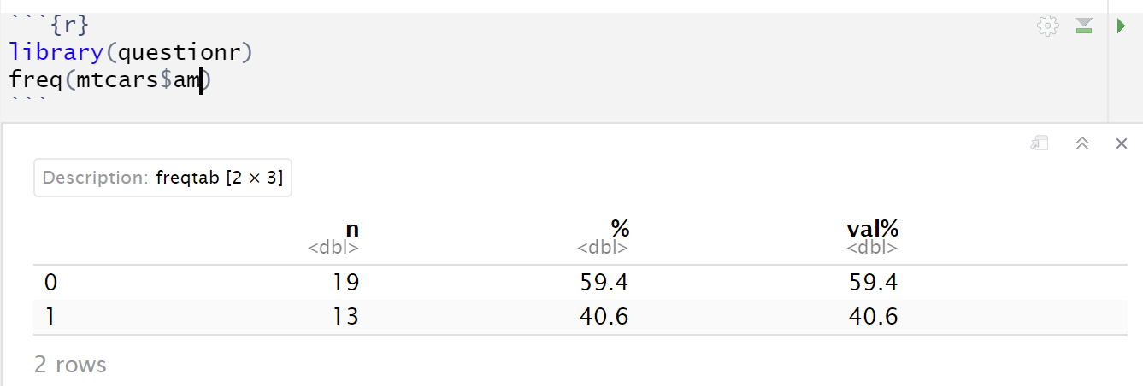
Binary variable
Binary Variables: Variables with two categories (e.g., yes/no, male/female)
Flat sorting, You can use the table() functions and the freq() function of the questionr library
freq accepts a number of arguments to customize its display. Like what: • valid: indicates whether or not you want to display percentages on valid values • cum: indicates whether or not you want to display the cumulative percentages • total allows you to add a row with the total number of rows • sort: sorts the array by increasing frequency (sort="inc") or decreasing frequency (sort="dec").

Slide 19
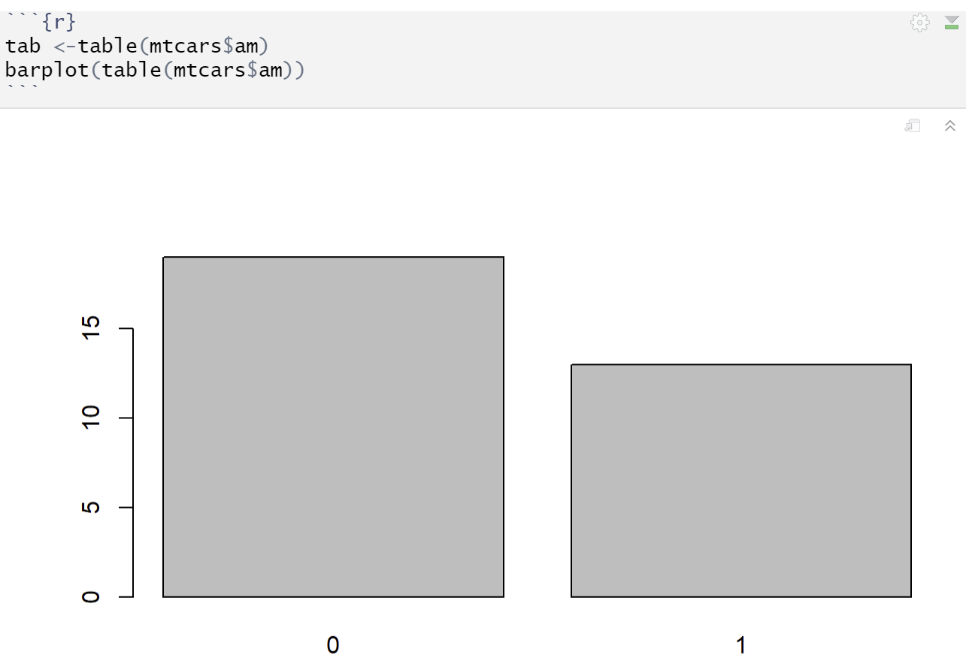
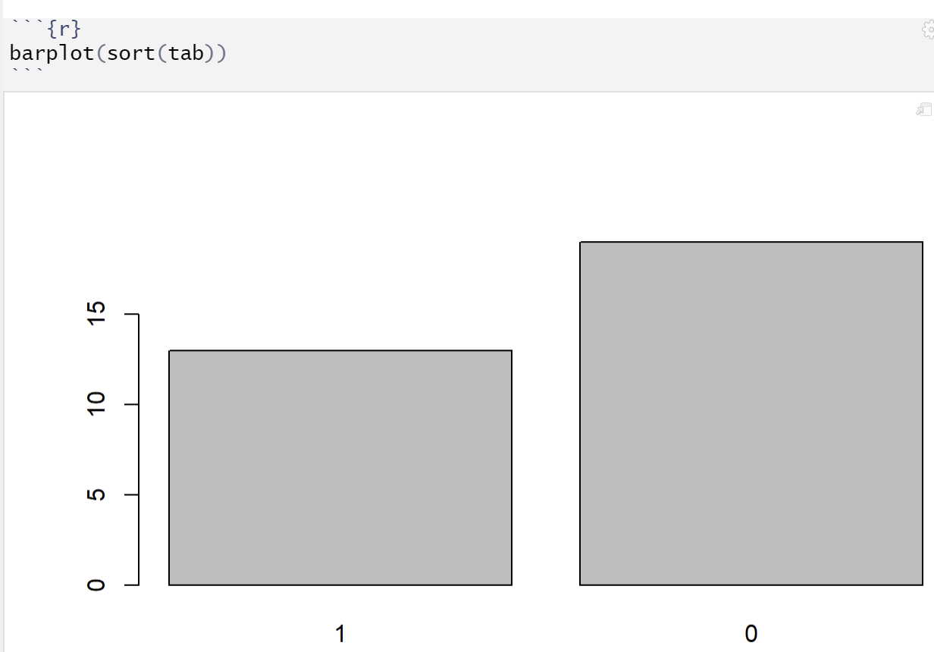
Bar plot
Bar chart, use the barplot() function
Sort Flat Sort with the sort() function

Slide 20
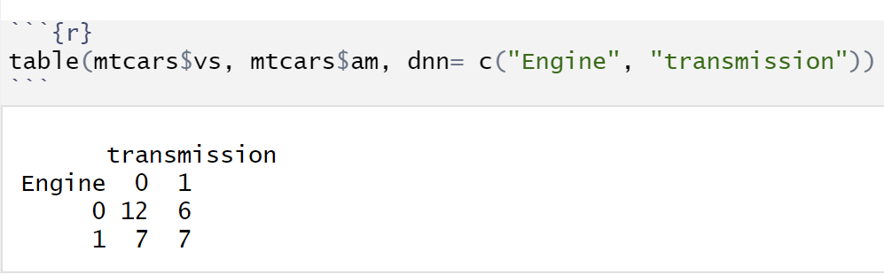
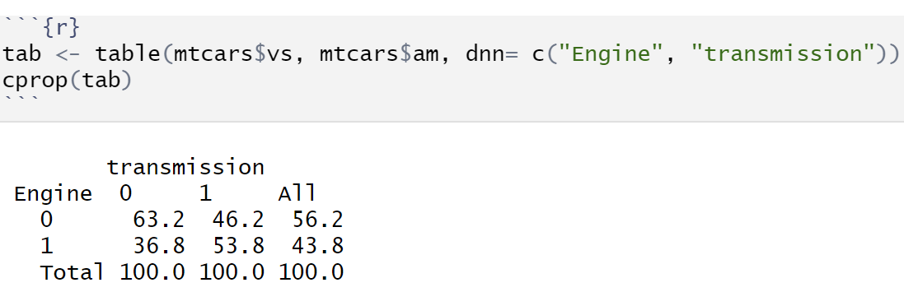
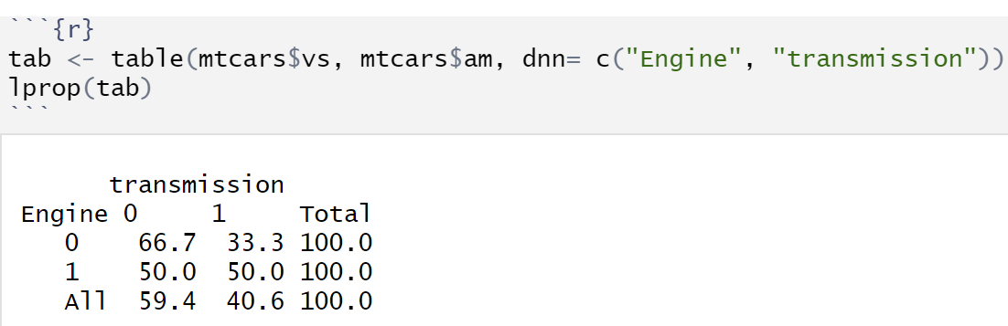
Bivariate Analysis: Cross-Tabling
Use the table() function to cross two qualitative variables
cprop() for column percentages
Use lprop() to calculate the line percentages

Slide 21
Introduction to Tidyverse
This is a collection of designed extensions that address a very large number of common operations in R (the list is not exhaustive): •visualization • Manipulation of data tables • Data import/export • Manipulation of variables • Extracting data from the web •programming
Installation
ggplot2 (visualization) dplyr (Data Manipulation) tidyr (Data Formatting) purrr (programming) readr (Data Import) tibble (Data Tables) forcats (Qualitative Variables) stringr (strings)
install.packages("tidyverse")
This command installs several extensions such as

Slide 22
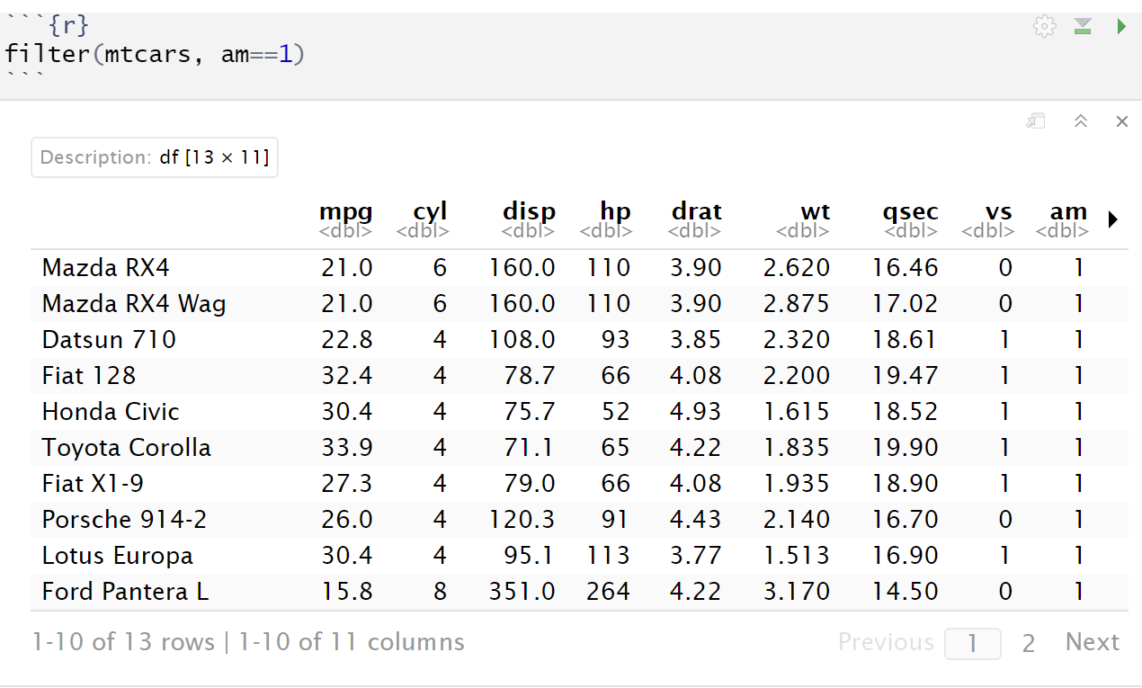
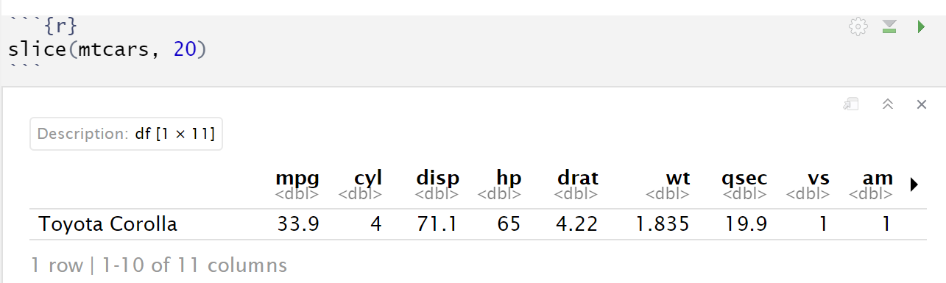
Manipulating data with dplyr
Select rows in the table according to their position, use the slice() function
Select the rows of a table according to a condition, Use the filter() function Selecting car with transmission is manual
Select the 20th row of the mtcars data
If we want to select the first 10 rows, we can make slice(mtcars, 1:10)

Slide 23
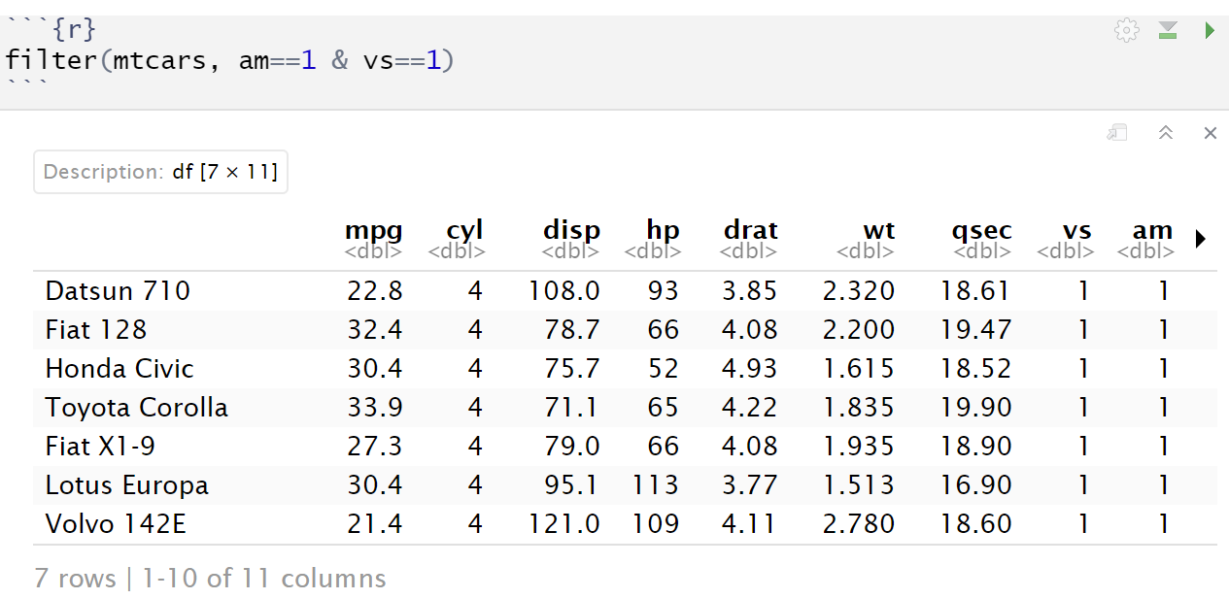
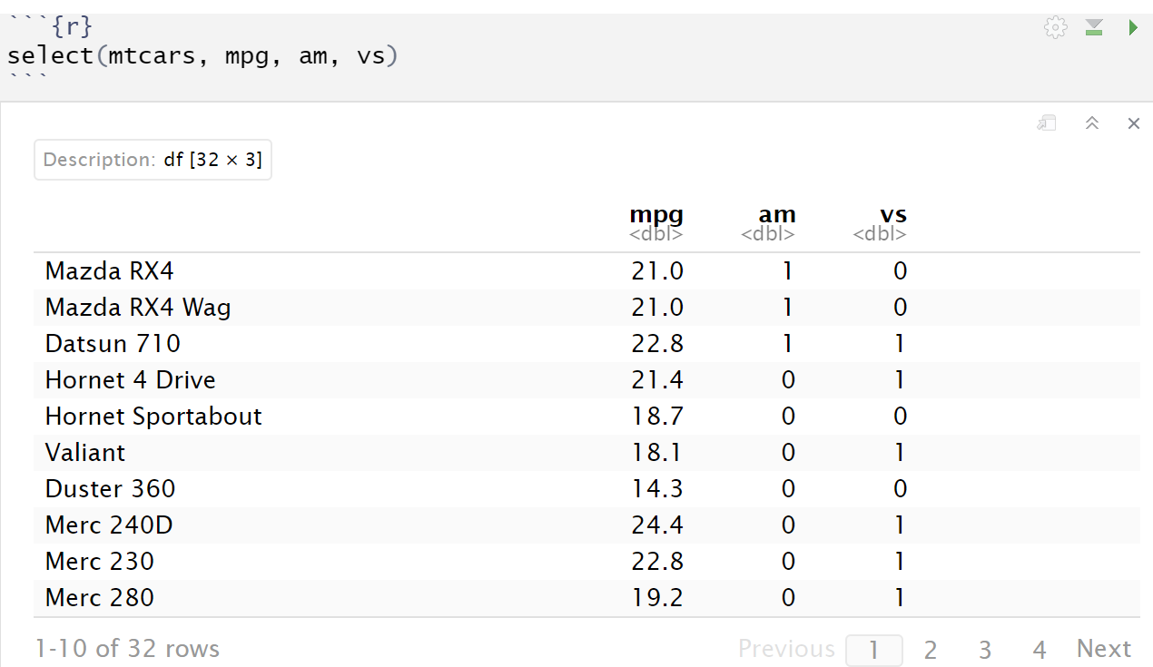
Manipulating data with dplyr
If we want to select car with am=1 and vs=1
To select columns from a data table, we use the select() function. Select the mpg, am and vs columns
If the name is preceded by a -, the column is eliminated rather than selected Ex: select(mtcars, -gender, -age)

Slide 24
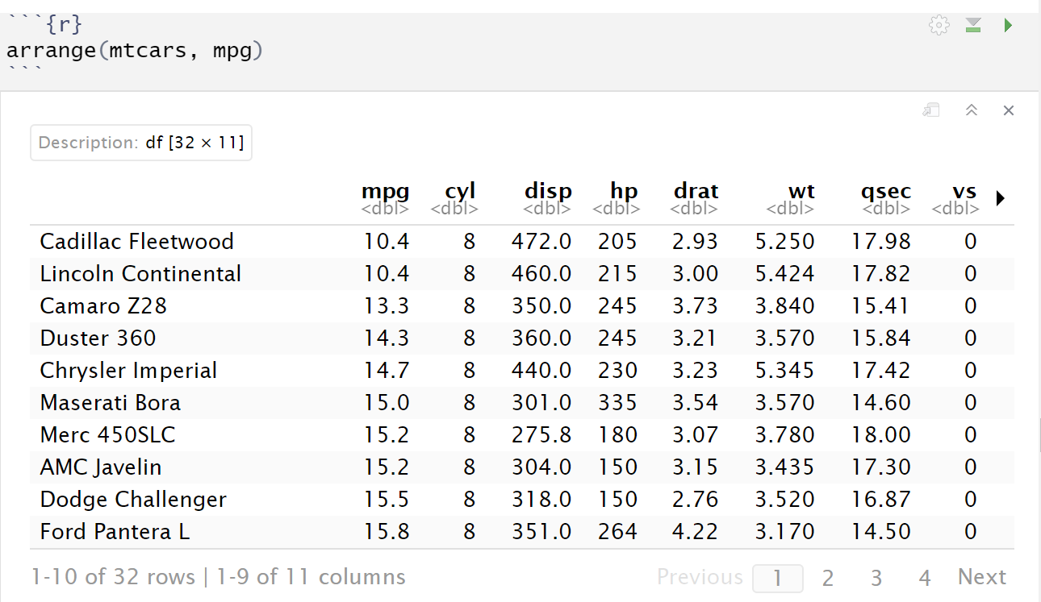
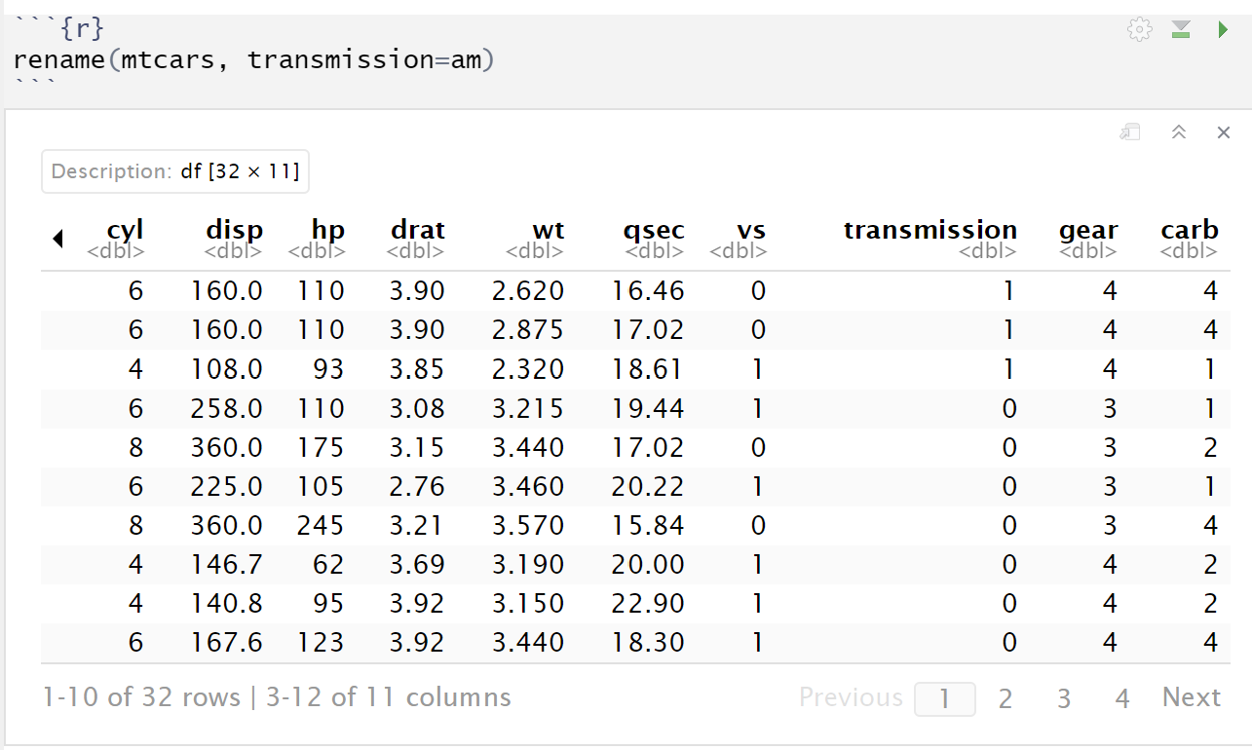
Manipulating data with dplyr
The syntax column1:column2 allows you to select all columns between column1 and column2 included. Ex: select(mtcars, mpg-am) selects all columns between mpg and am
To reorder rows in a table by one or more columns. We use the arrange() function Ex: Order the table by the variable mpg from smallest to largest
Rename columns. We use the rename() function. It is used by passing parameters of the form new_name = old_name
For descending order, we use desc(). Ex: arrange(mtcars, desc(mpg))

Slide 25
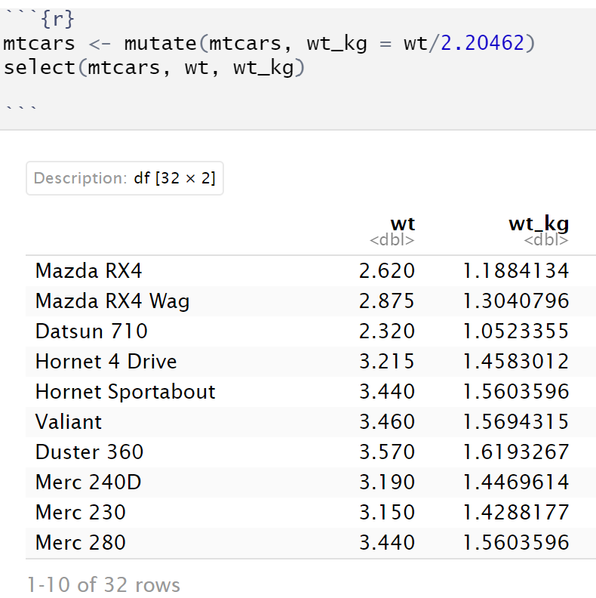
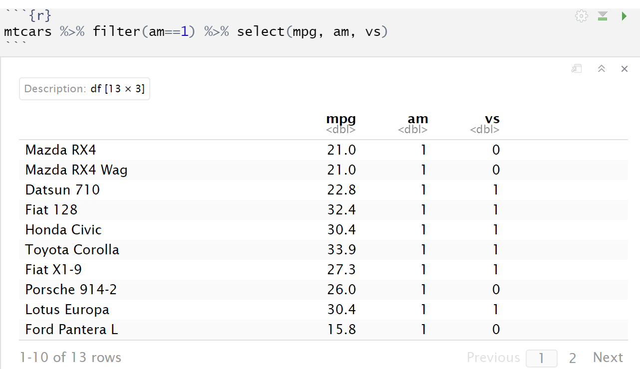
Manipulating data with dplyr
To create new columns in the data table, we use the mutate() function
Link operations with the pipe
To link several operations, for example to do a filter, a select, a mutate at the same time, we can use the pipe operator which is denoted %>% filter(mtcars, am==1) is equivalent to mtcars%>% filter(am==1)
Example: Let’s convert weight (1000lbs) (wt) to (1000kg).

Slide 26
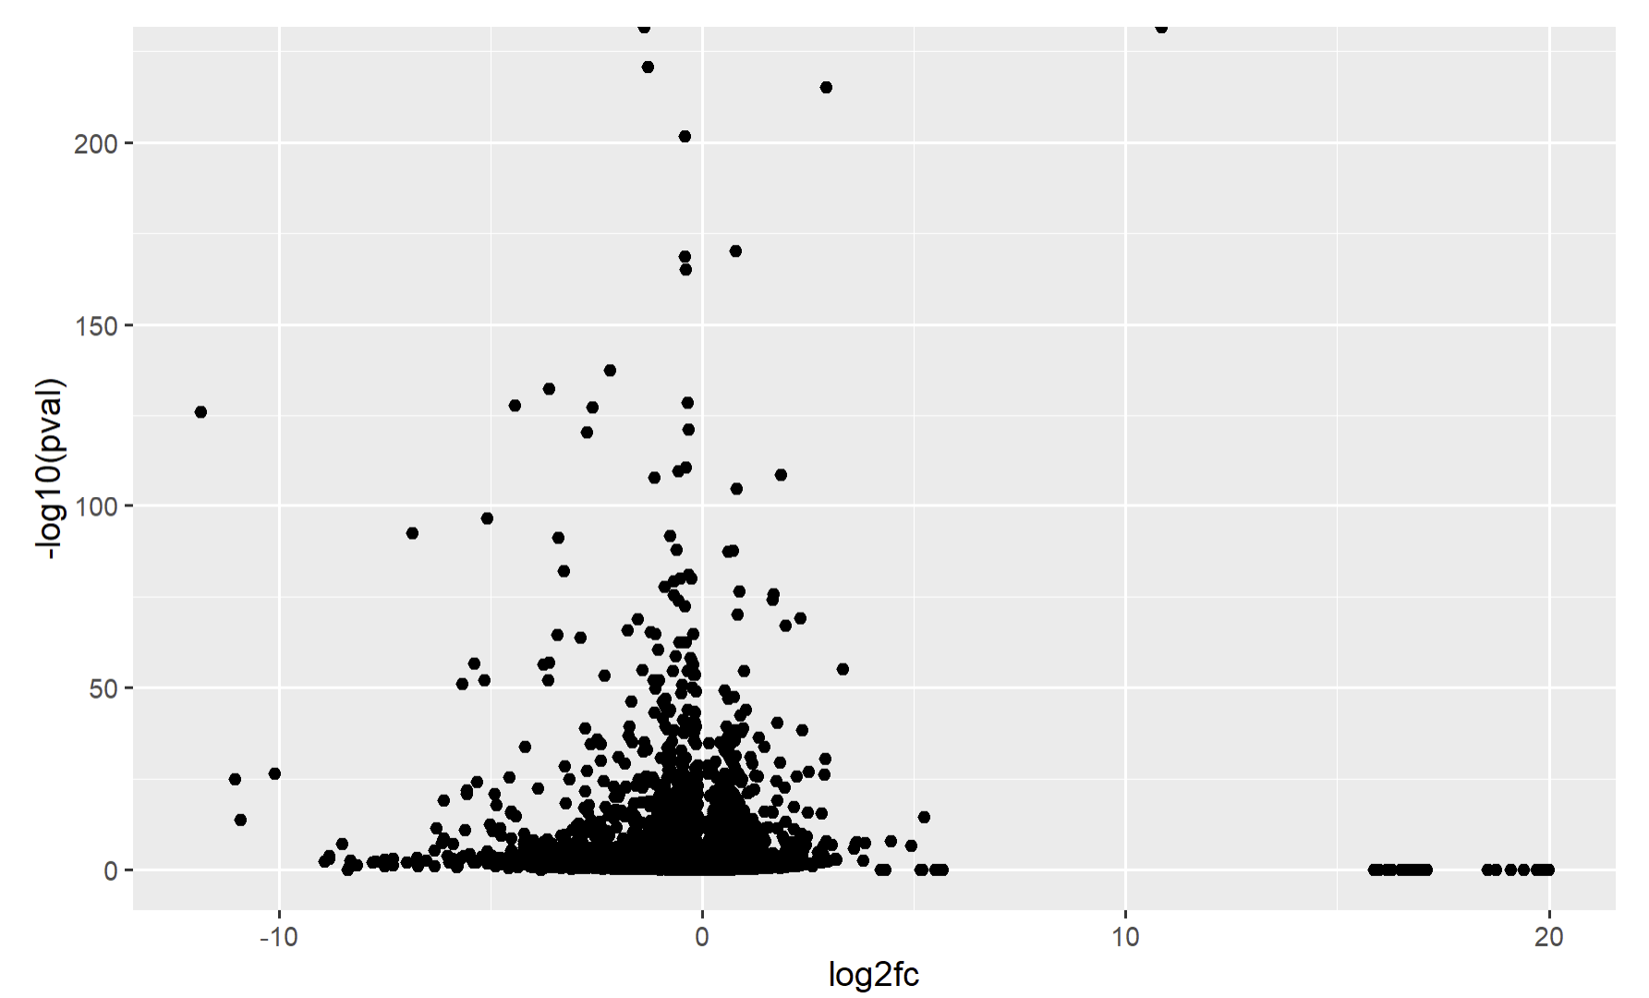
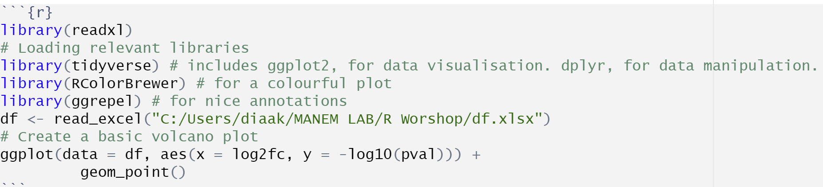
Create a volcano plot
For this tutorial, we use the single-cell RNA-seq dataset of human COVID T cells from Bacher et al. (2020). You can learn more about this dataset and get it for free at https://rdrr.io/github/LTLA/scRNAseq/man/BacherTCellData.html Data already processed with differential gene expression are available here https://biostatsquid.com/severevshealthy_degresults-3/
To make a basic volcano plot, o can use ggplot() along with geom_point()

Slide 27
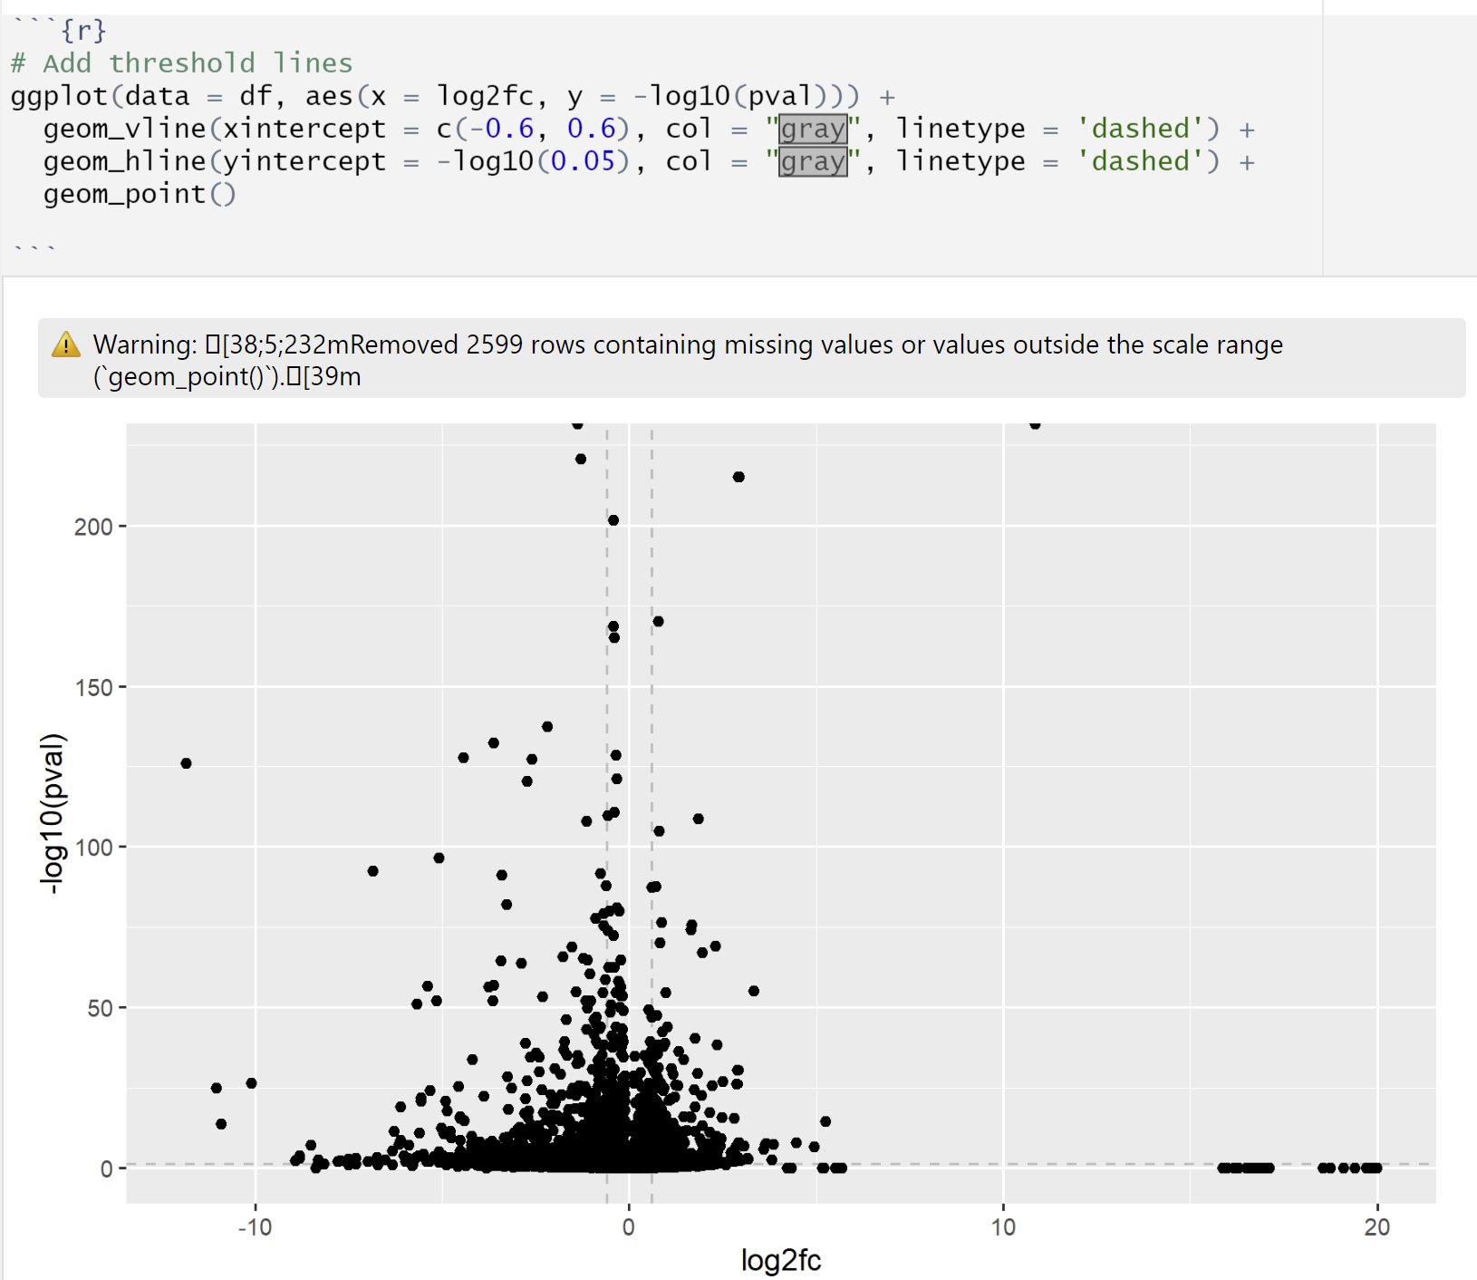
Create a volcano plot
Add the threshold lines, we use geom_vline() and geom_hline()

Slide 28
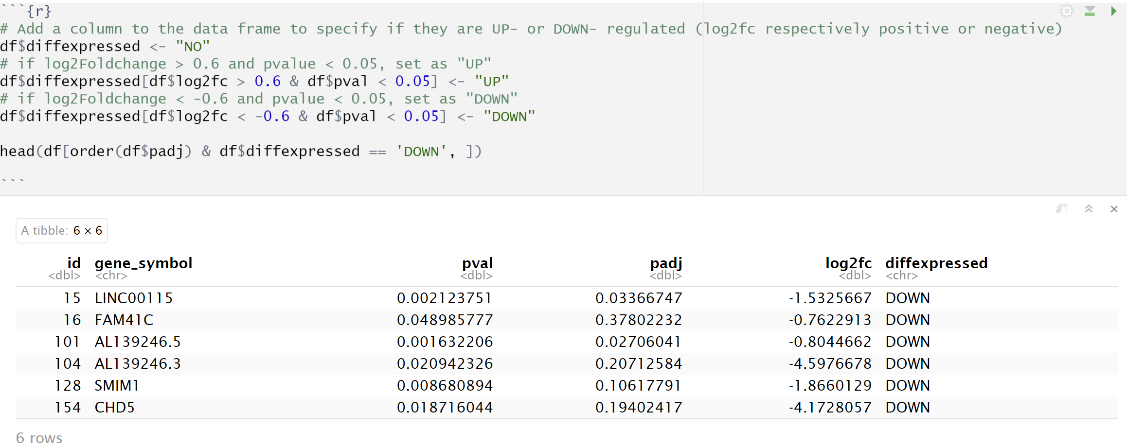
Create a volcano plot
Determine upregulated, downregulated, and non-significant genes

Slide 29
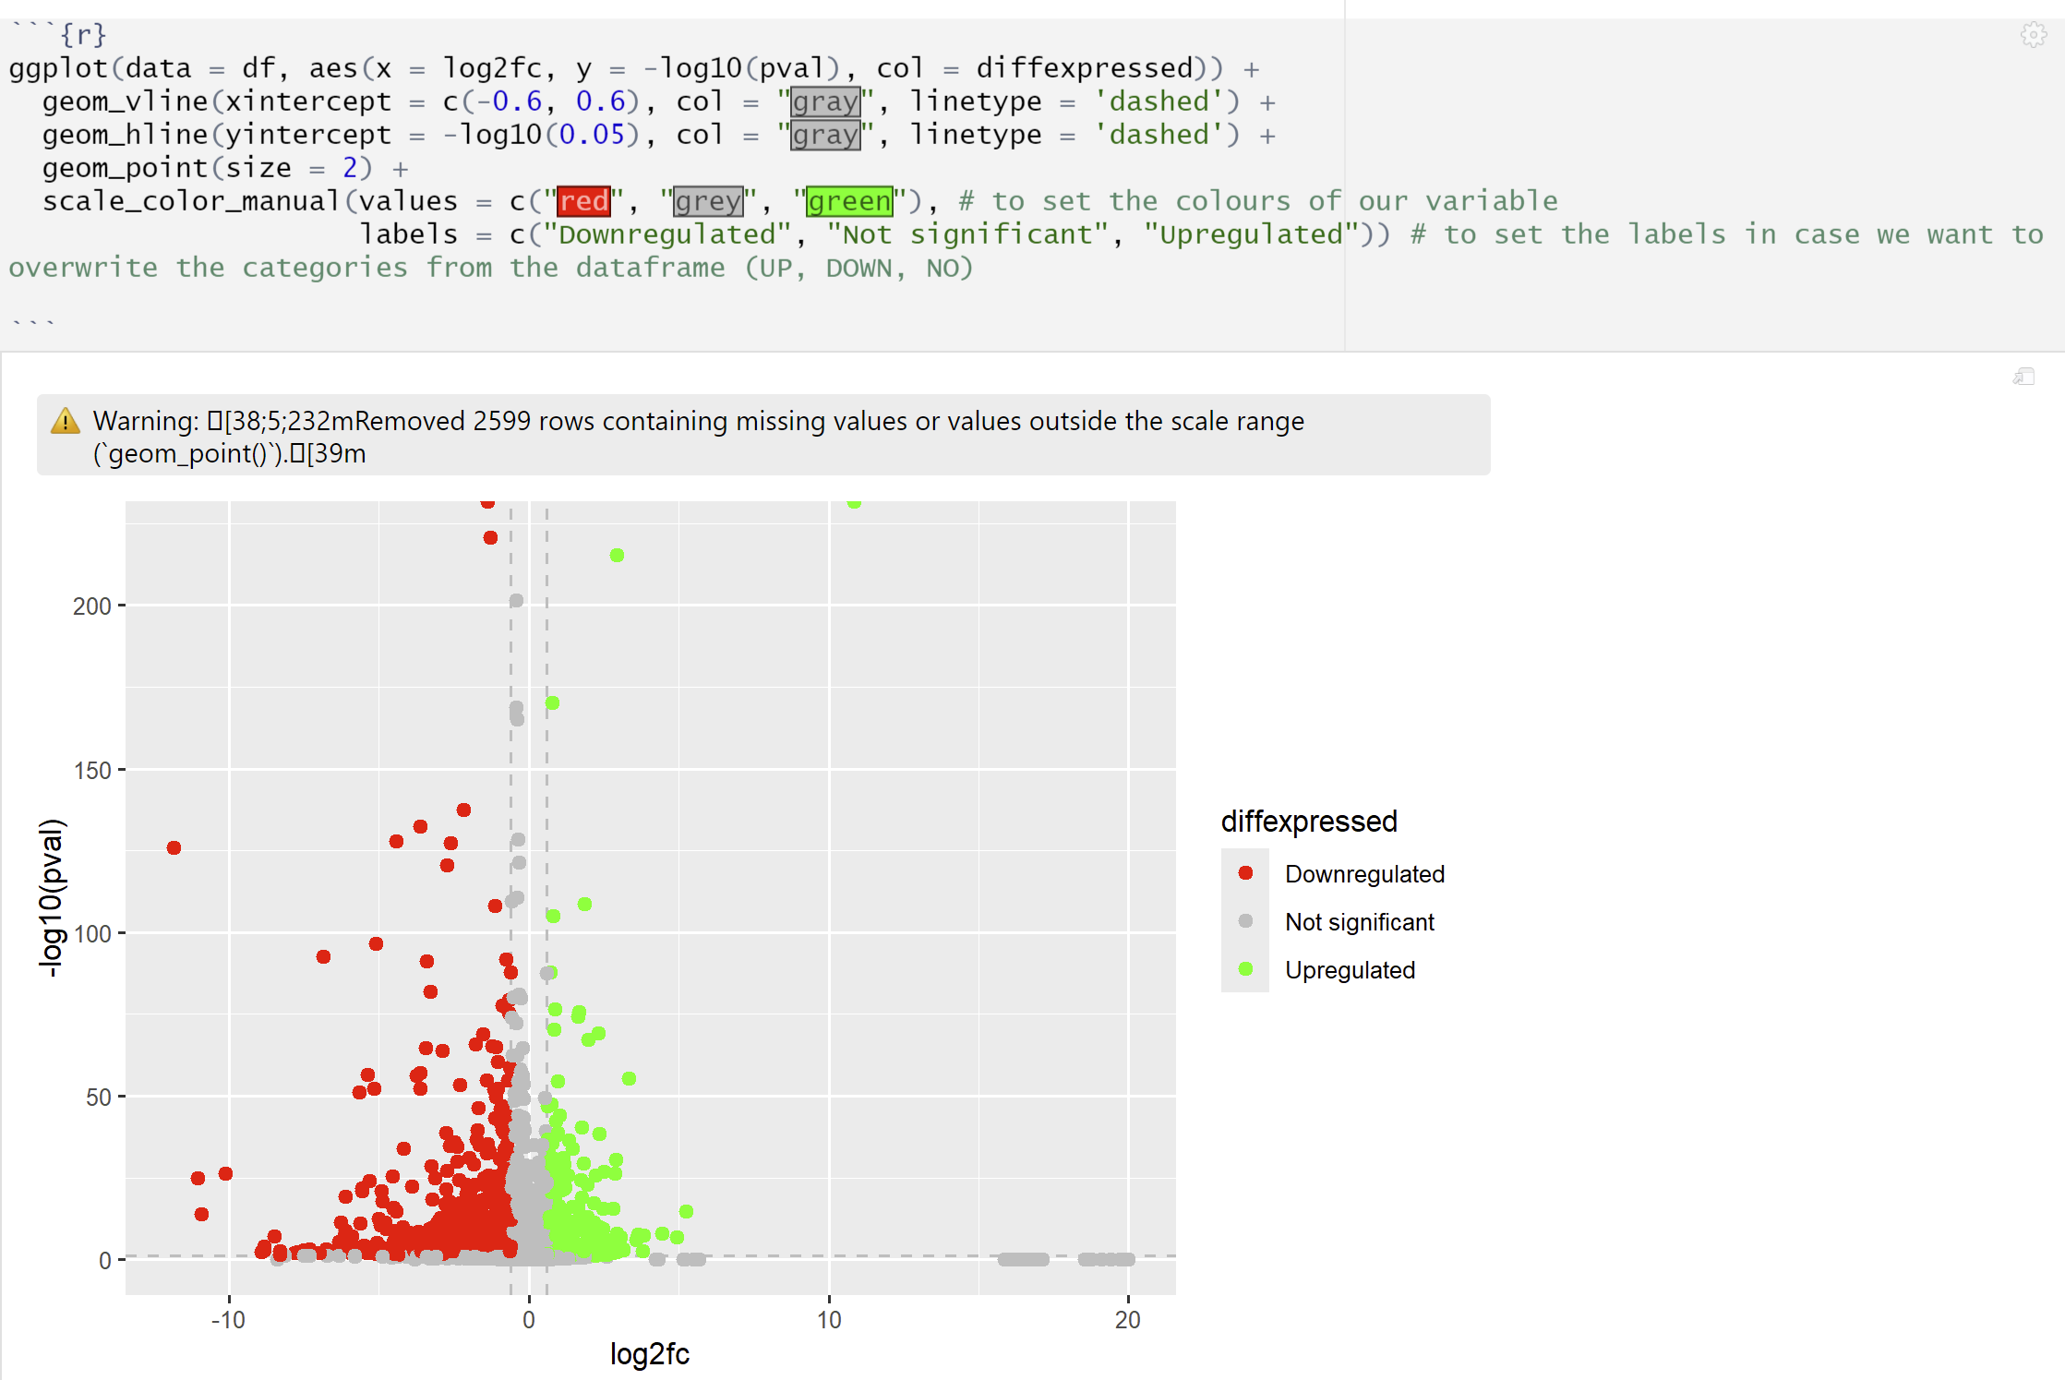
Create a volcano plot
Now we can plot the volcano plot with ggplot with geom_point. scale_color_manual() gives the 3 different colors. To label UP, DOWN, NO, we use labels().

Slide 30
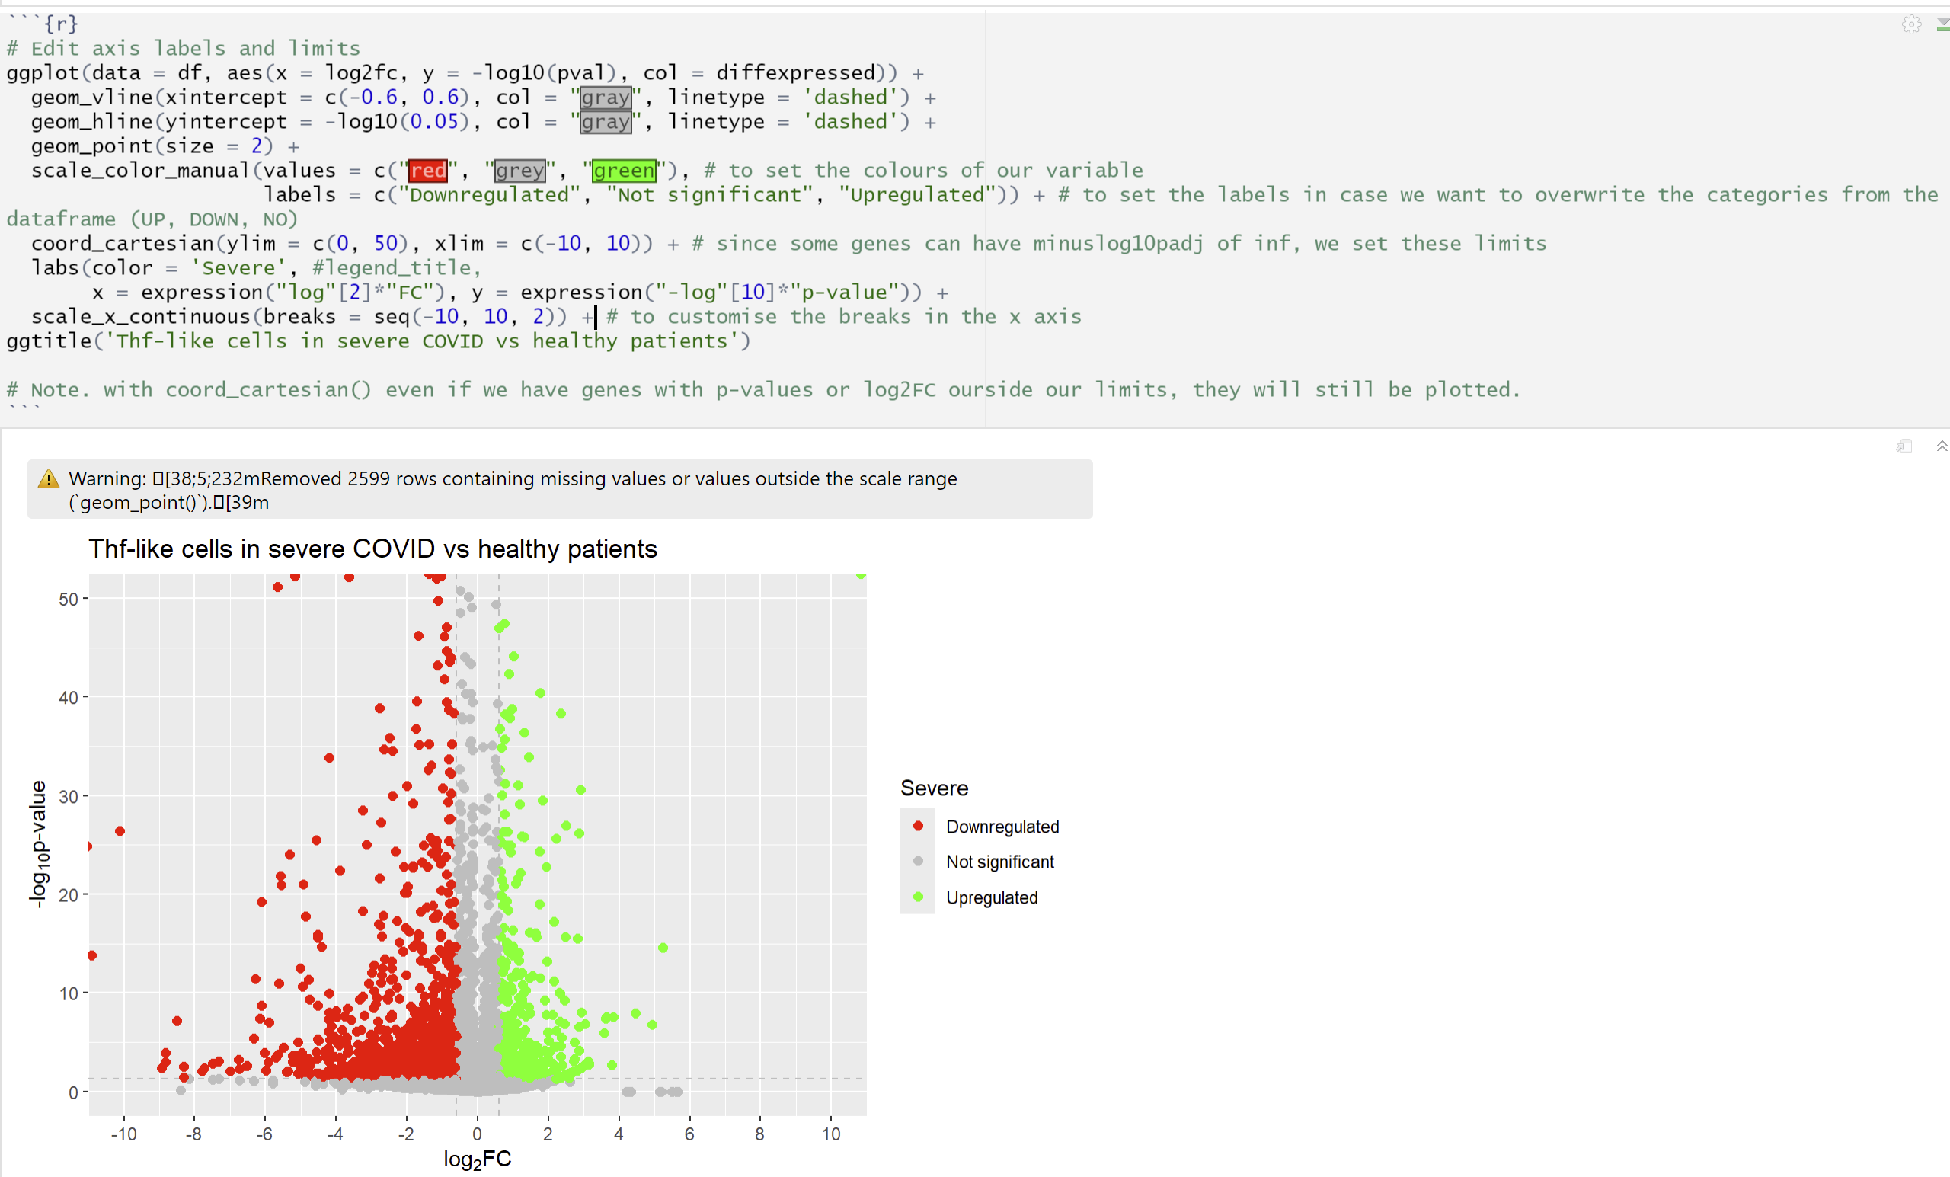
Create a volcano plot
We limit the y-axis to 50 (0 – 50) and the x-axis to [-10,10 ] to limit values. We use coord_cartesian() and scale_x_continuous()
To access the tutorial https://biostatsquid.com/volcano-plots-r-tutorial/

